Slide 1
01
4TH September – 8TH September 2023
Gurupadhigam

Slide 2
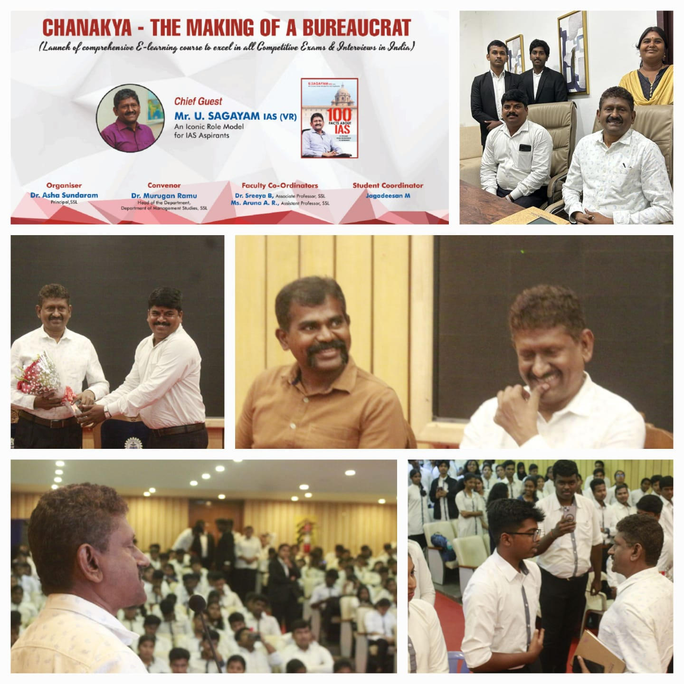
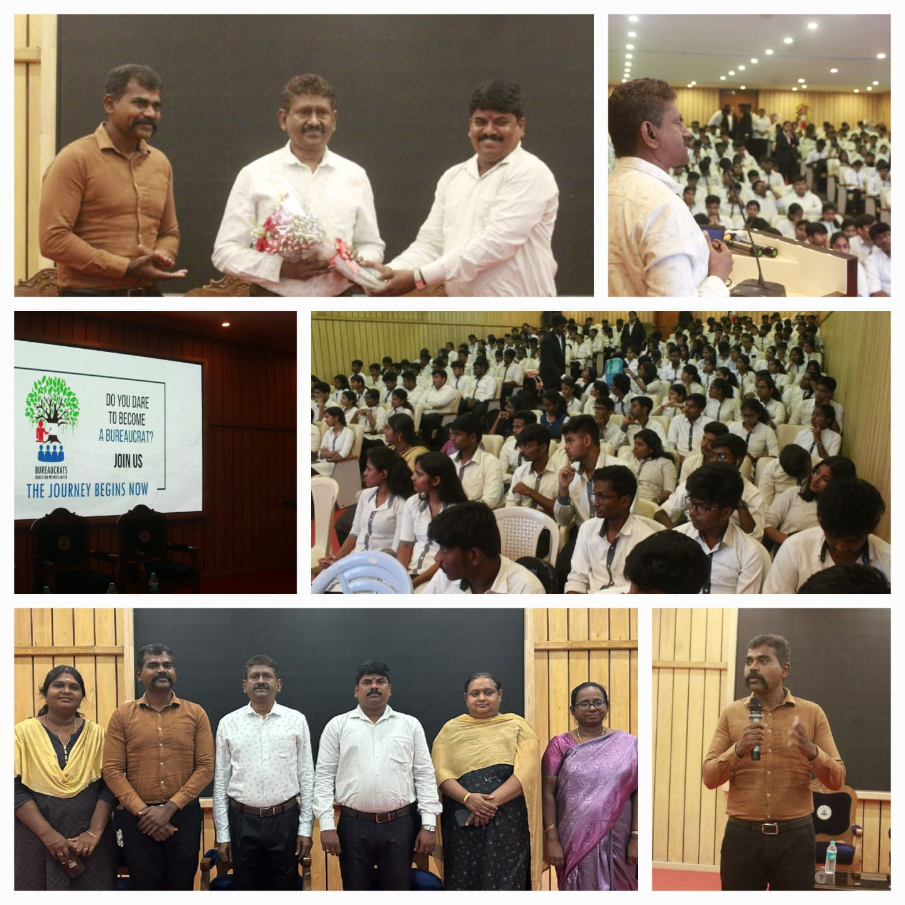
02
E –Learning course
Department of Management Studies, SSL has organised "Chanakya - The Making of a Bureaucrat" Launch of E-Learning Course to excel in all major Competitive Exams in collaboration with Bureaucrats Education Private Limited on September 04, 2023. Mr. U Sagayam IAS (VR), an iconic role model for IAS aspirants, was the program's Chief Guest. Mr. Gautham Shanmugam, Founder & Director, Bureaucrats Education Private Limited, provided an overview of the E-Learning course, which is designed with the primary goal of making education accessible and affordable to all students in India, regardless of economic background. Mr. U Sagayam IAS (VR) was introduced and thanked for his presence. The chief guest also emphasised the importance and necessity of becoming a bureaucrat. His book "100 Facts about IAS (A Journey from Recruitment)"was distributed to the students. This inaugural programme drew nearly 250 students. Dr. Sreeya B and Ms. Aruna A R have coordinated the E-Learning Course Launch Programme. This E-Learning course will be extremely beneficial to Saveetha students.

Slide 3
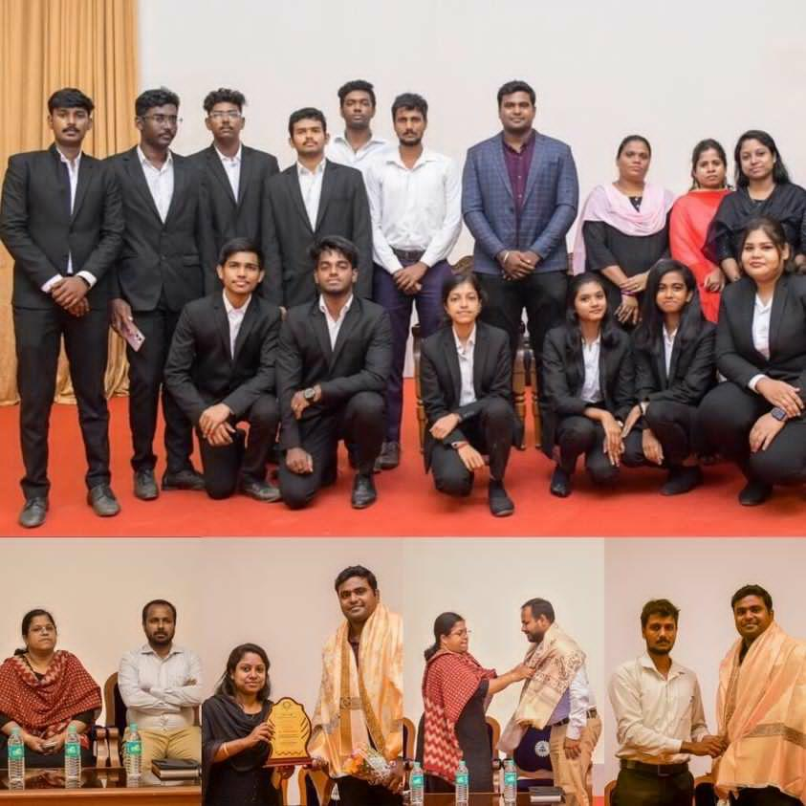
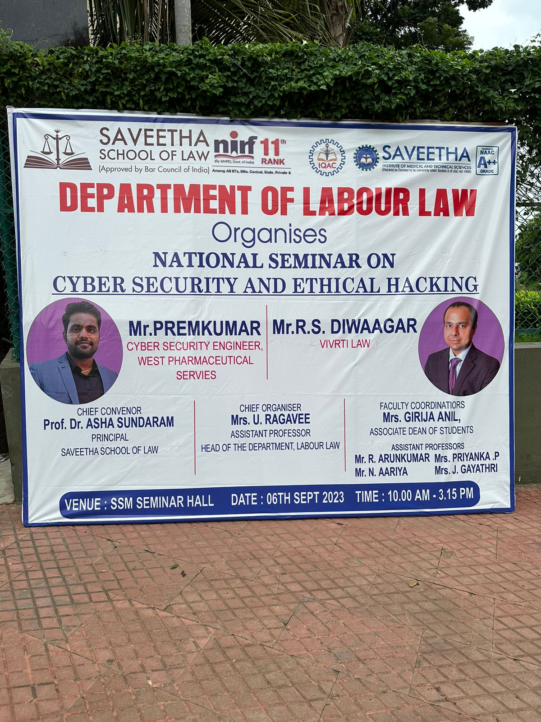
03
National Seminar
The Department of Labour and Industrial law headed by Mrs. Ragavee U along with other faculty co-ordinators- Mrs. Girija Anil, Mr. Arun Kumar R, Mrs. Priyanka P & Mrs. Gayathri J of Saveetha School of Law has organized a National Seminar on Cybersecurity and Ethical Hacking on 6th September, 2023 from 10.00 am to 03.15pm. More than 200 students have exhibited their enthusiastic participation in the event.

Slide 4
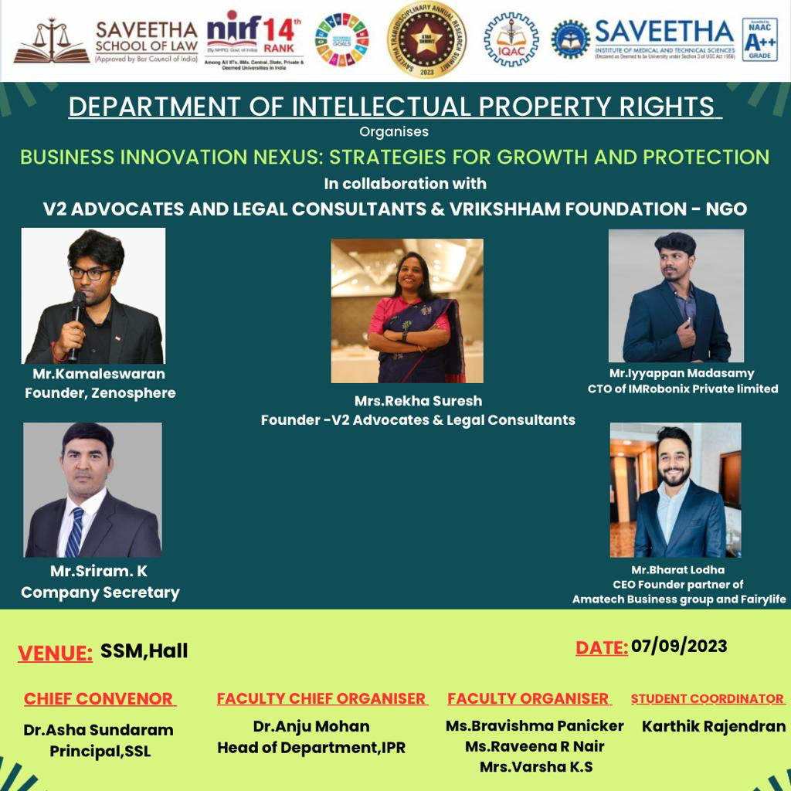
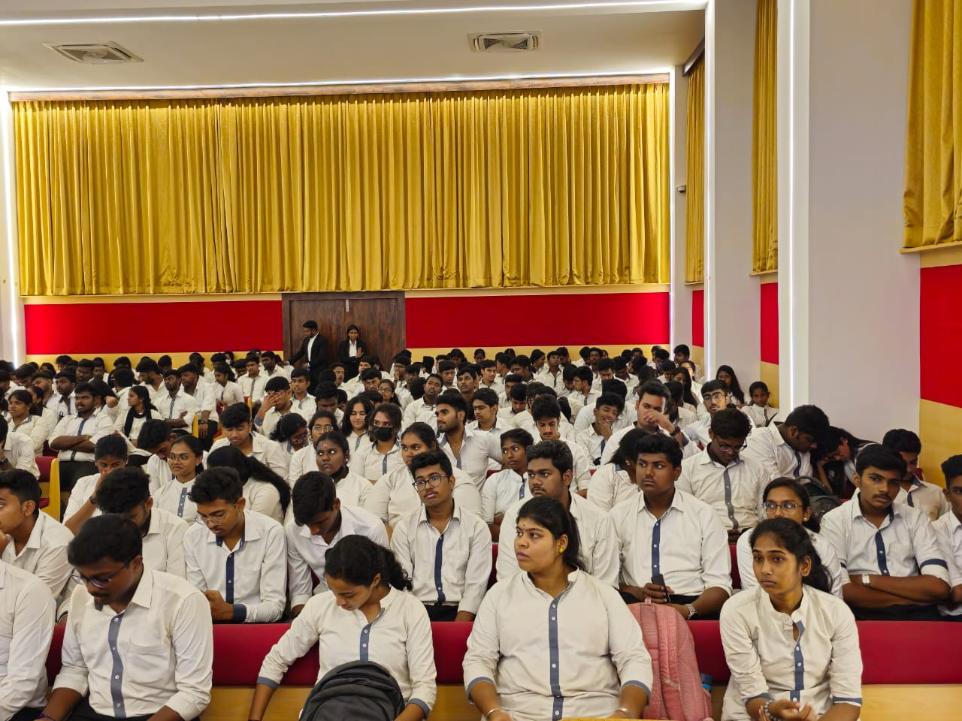
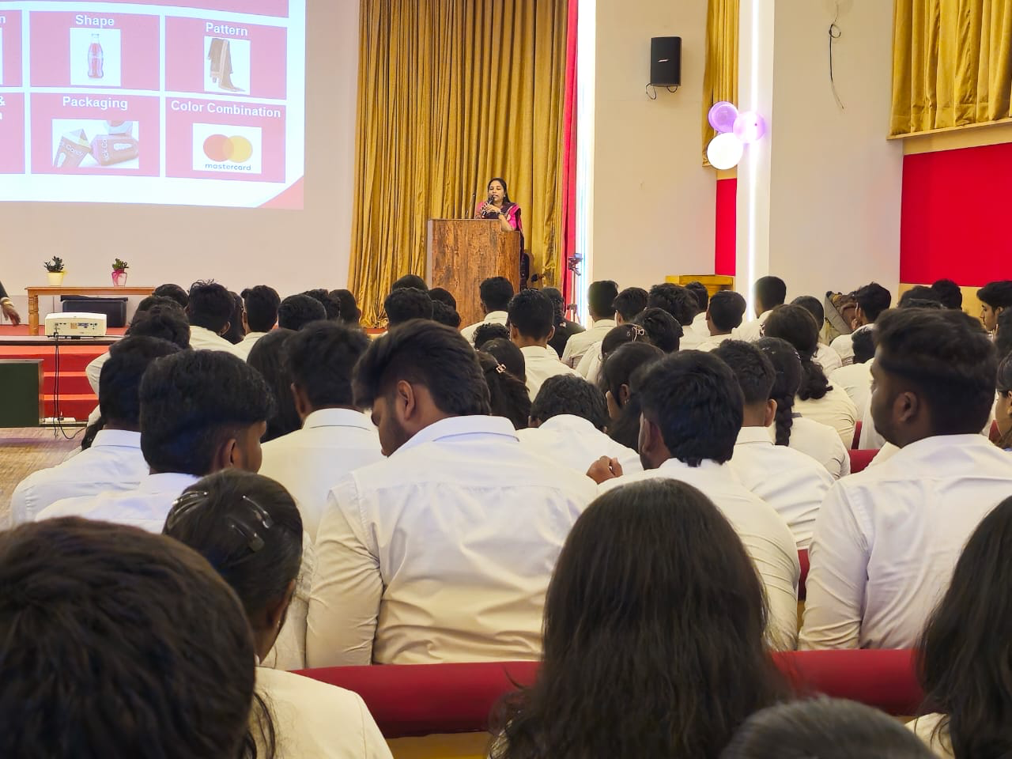
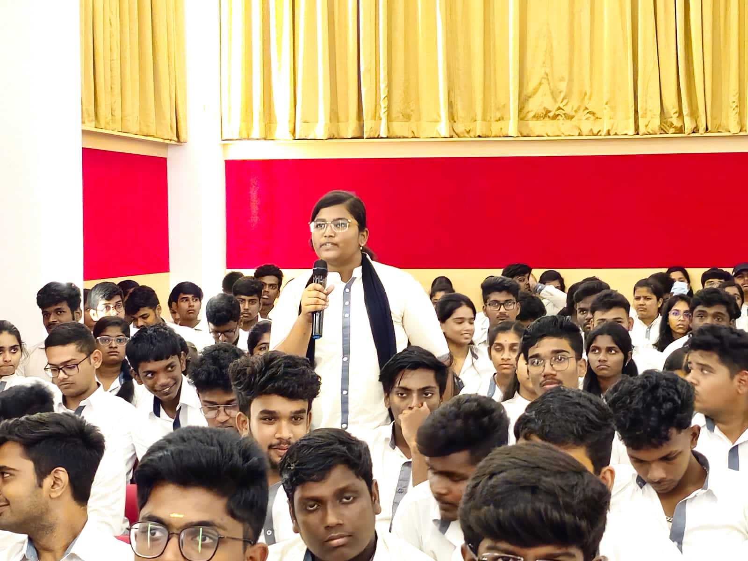
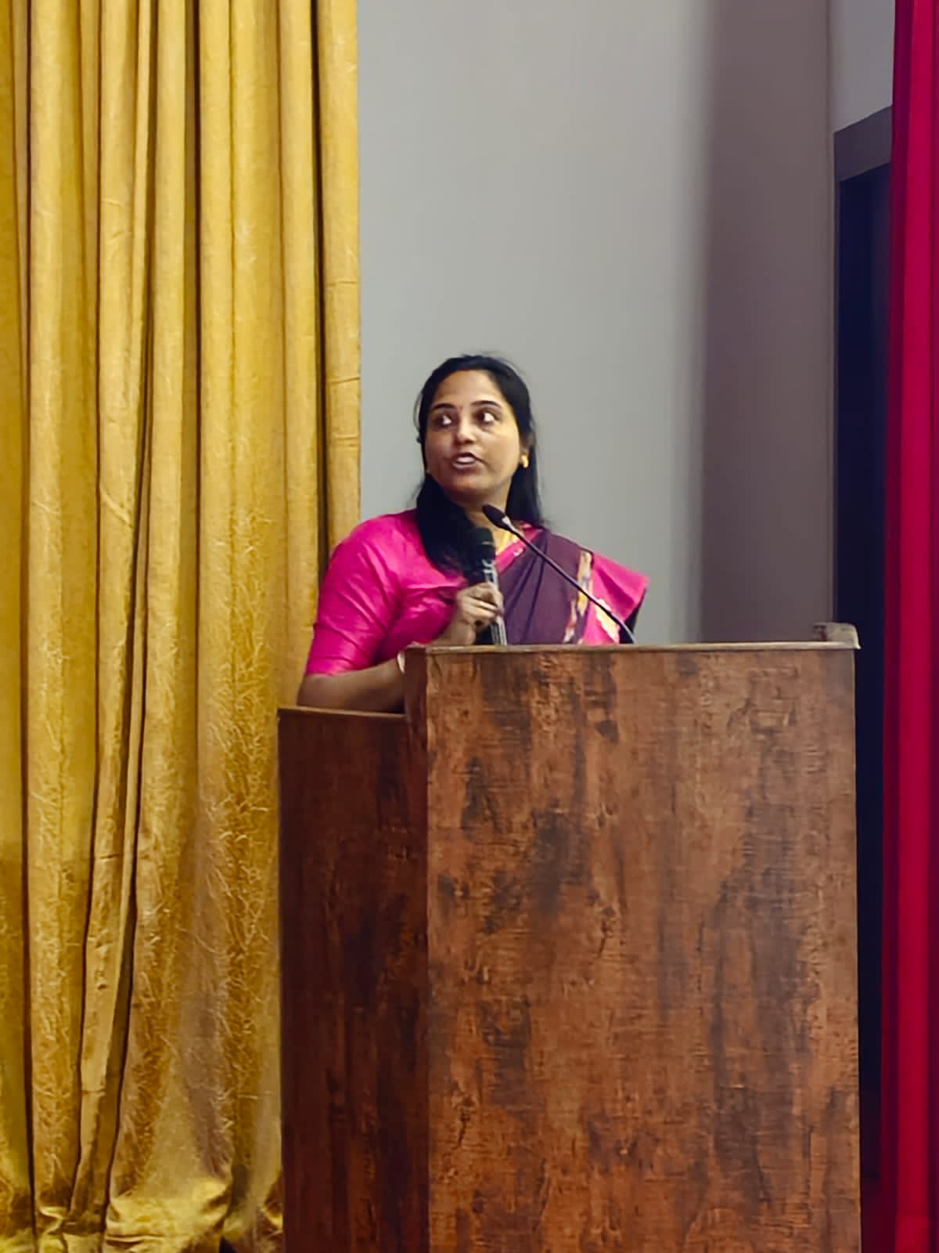
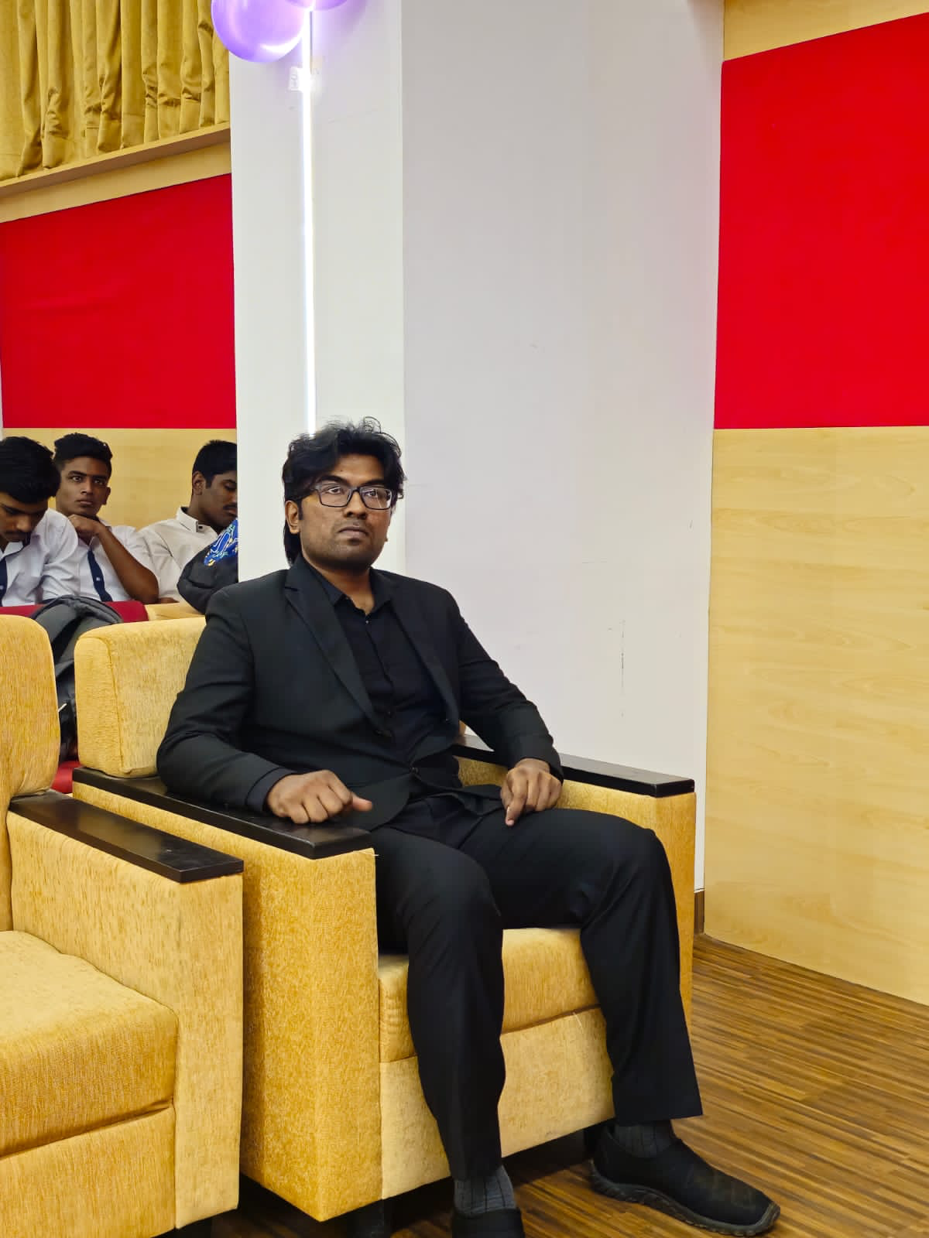
04
workshop
Saveetha School of Law's IPR department recently hosted an informative seminar and workshop titled "Business Innovation Nexus: Strategies for Growth and Protection." This event took place on September 7, 2023, from 9:30 AM to 3:00 PM. This event was held at the Saveetha School of Management Seminar Hall. This seminar welcomed 260 participants from the Saveetha School of Law, as well as students from other law schools and MBA programmes.

Slide 5
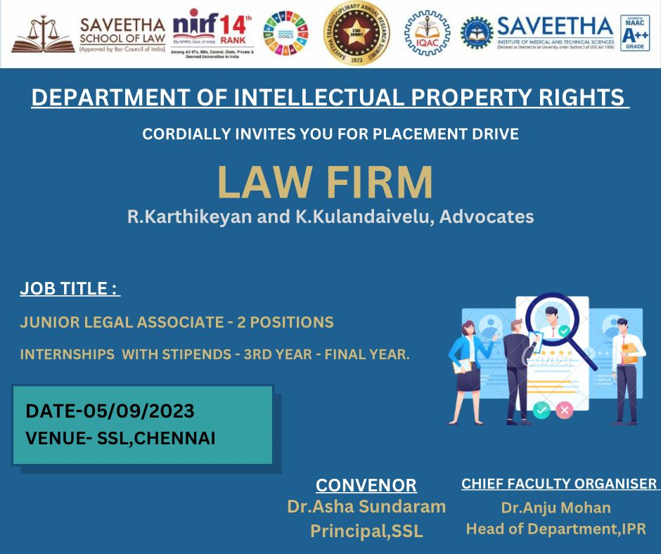
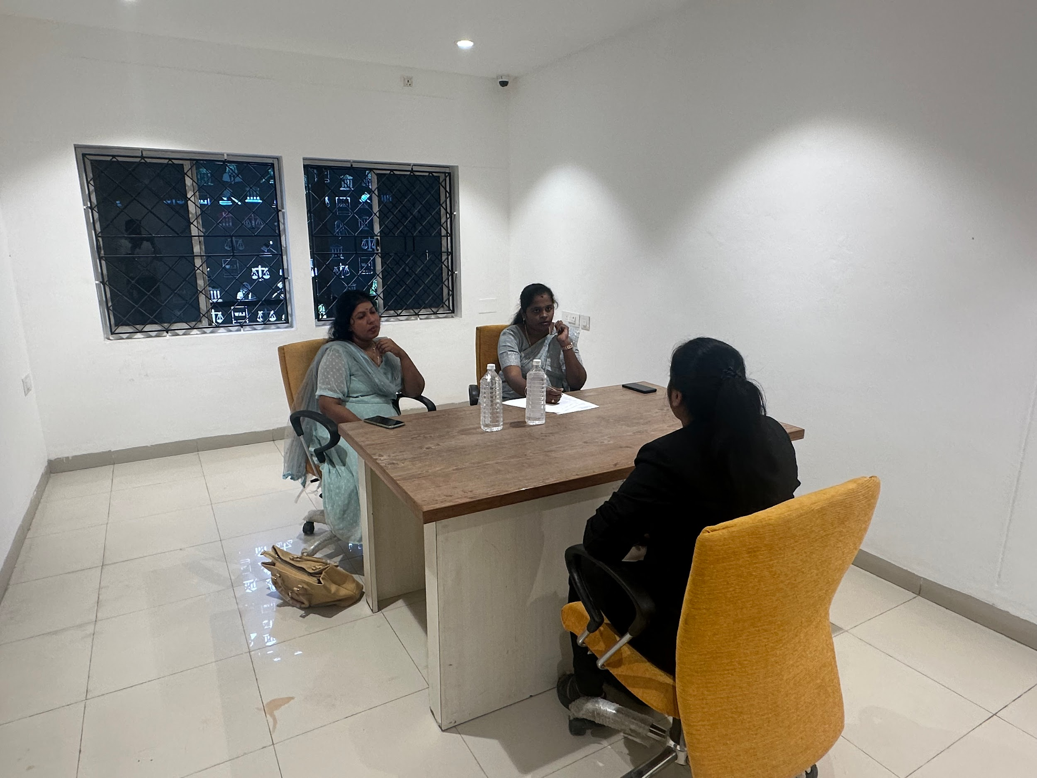
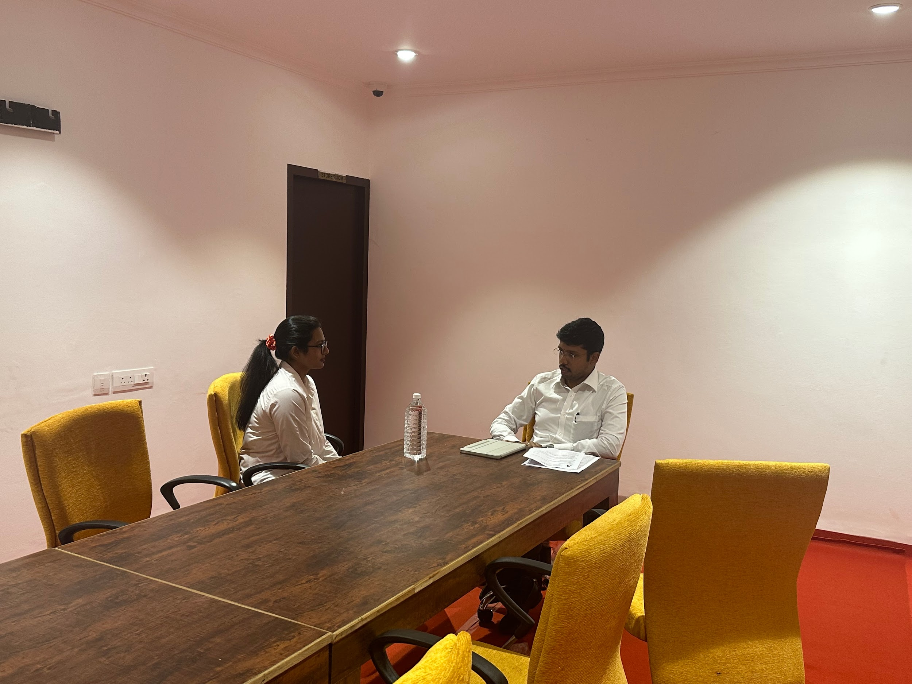
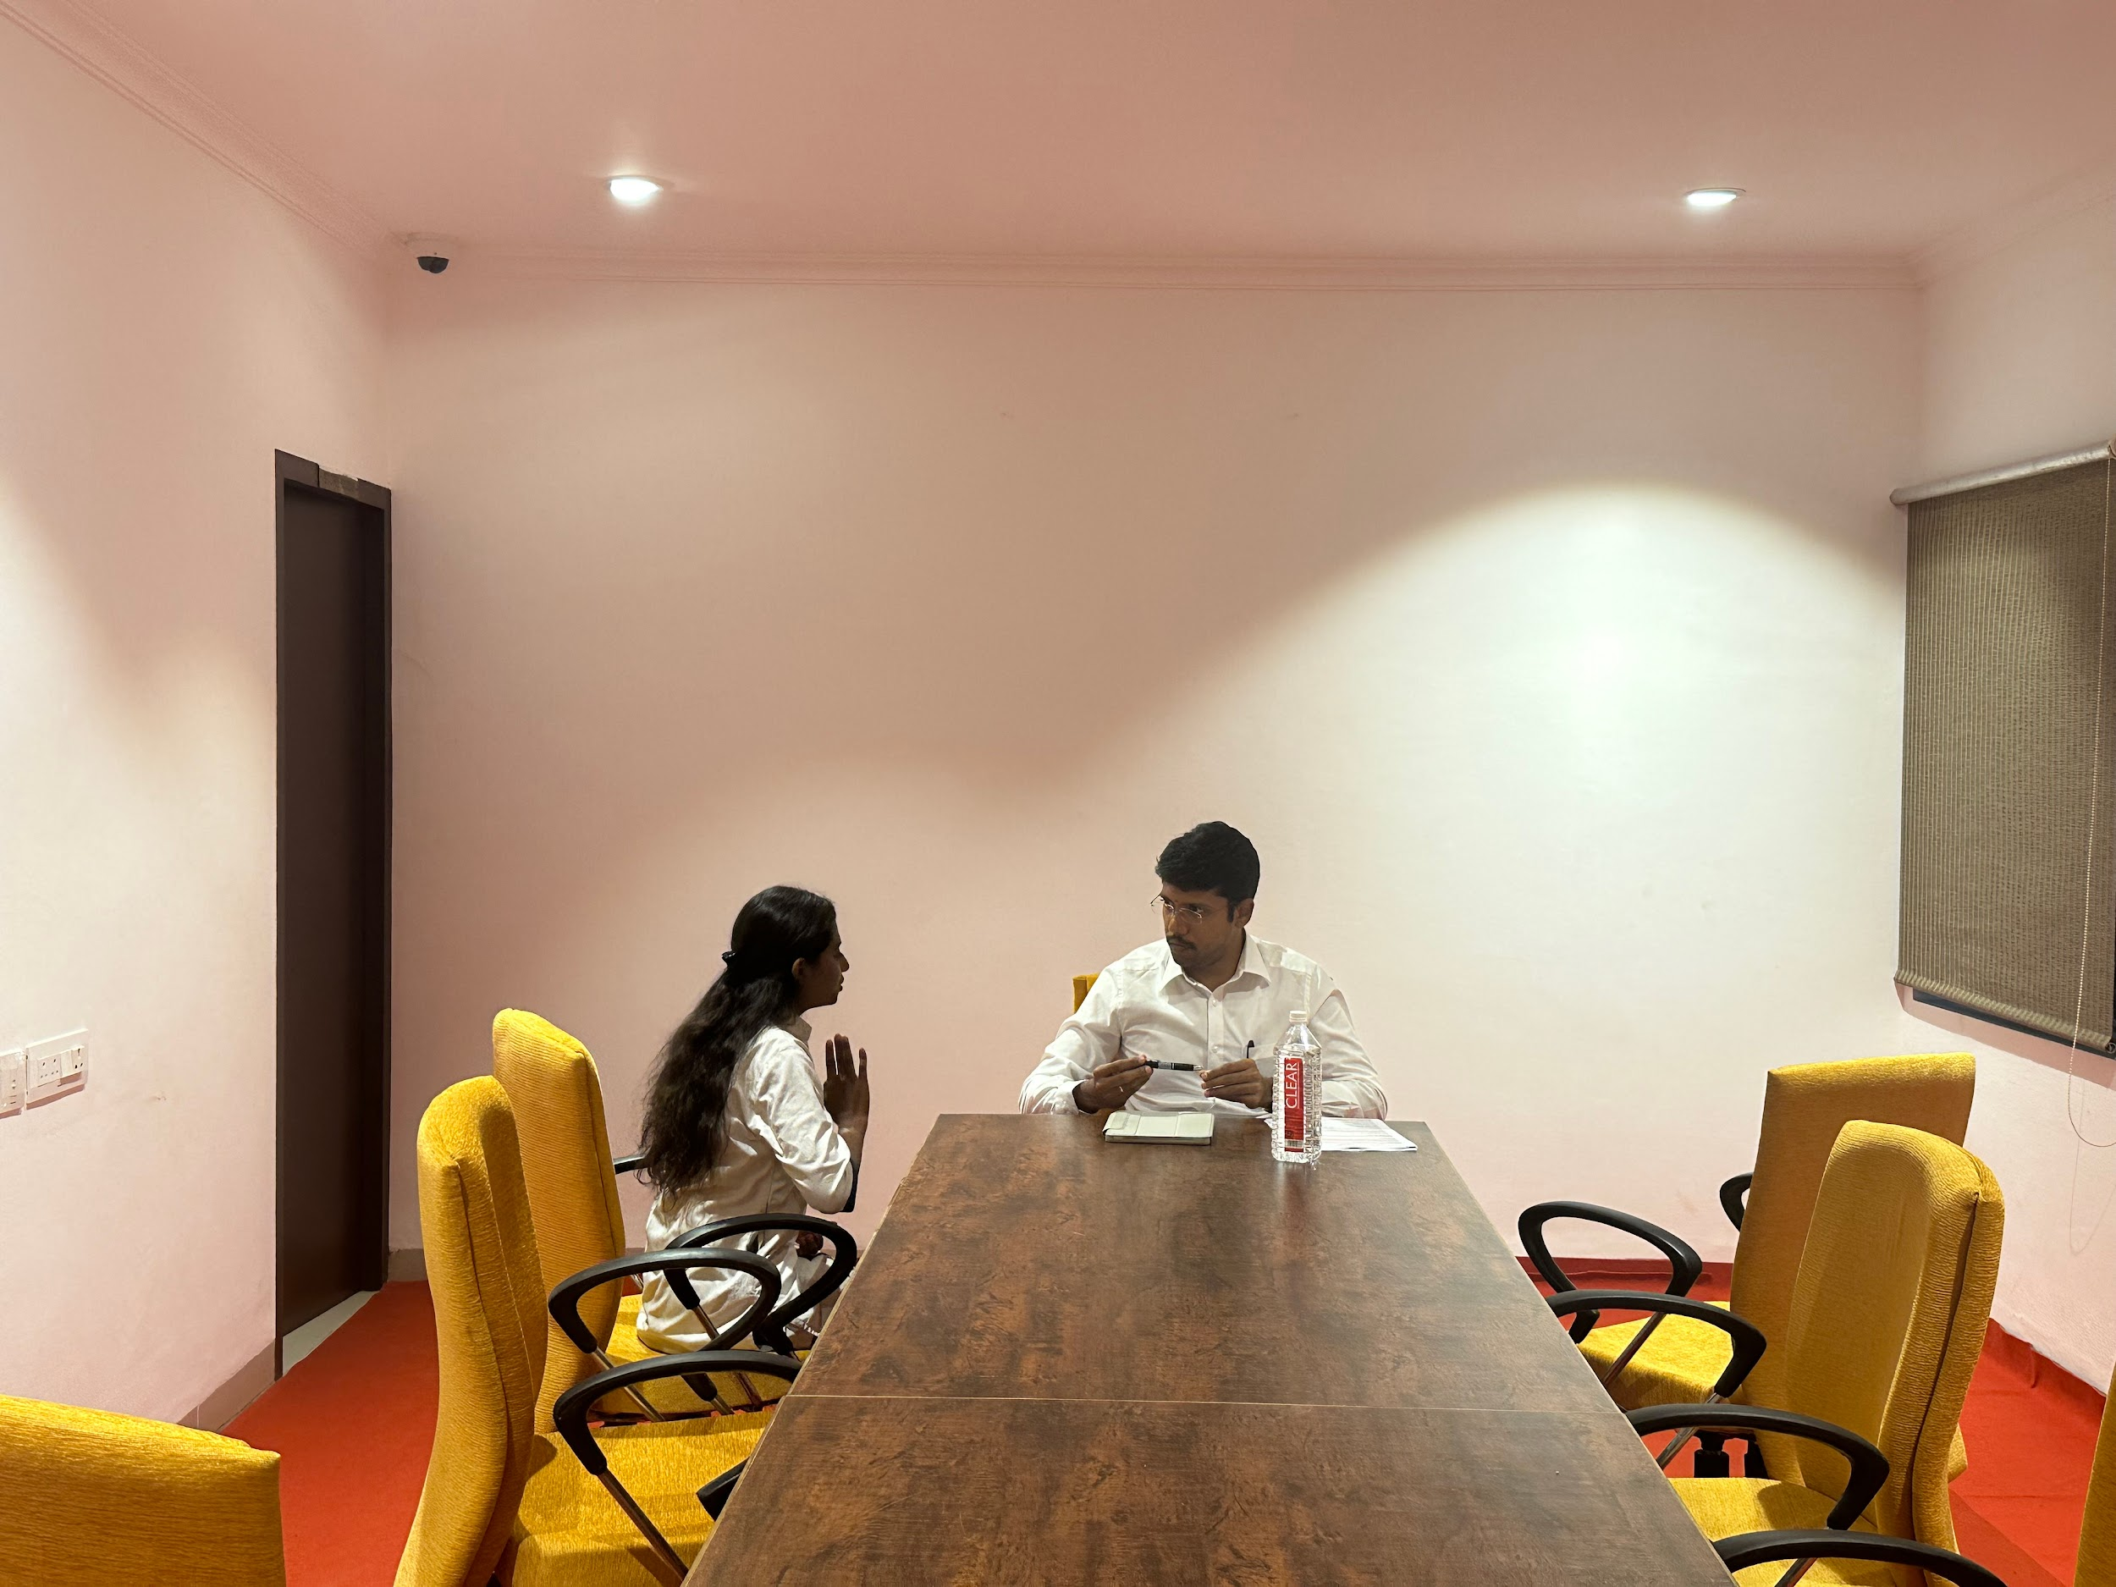
05
Placement
On September 5th, 2023, a highly influential placement drive took place at the prestigious Saveetha School of Law. This historic event was meticulously planned and managed by the Intellectual Property Rights (IPR) department. It featured prominent participation from Vakil Search and R. Karthikeyan & K. Kulandaivelu Advocate Firm, both of which extended career opportunities to our students.The event saw notable success among the 2018 batch students. Anakha S.J, Kanisha Pooja, and Sujith A.S all landed prestigious roles as legal advisors at Vakil Search, each with a competitive compensation package of $240,000. Rishi Saravanan, also from the 2018 batch, was awarded a prestigious internship with R. Karthikeyan & Kulandaivelu Advocate Firm

Slide 6
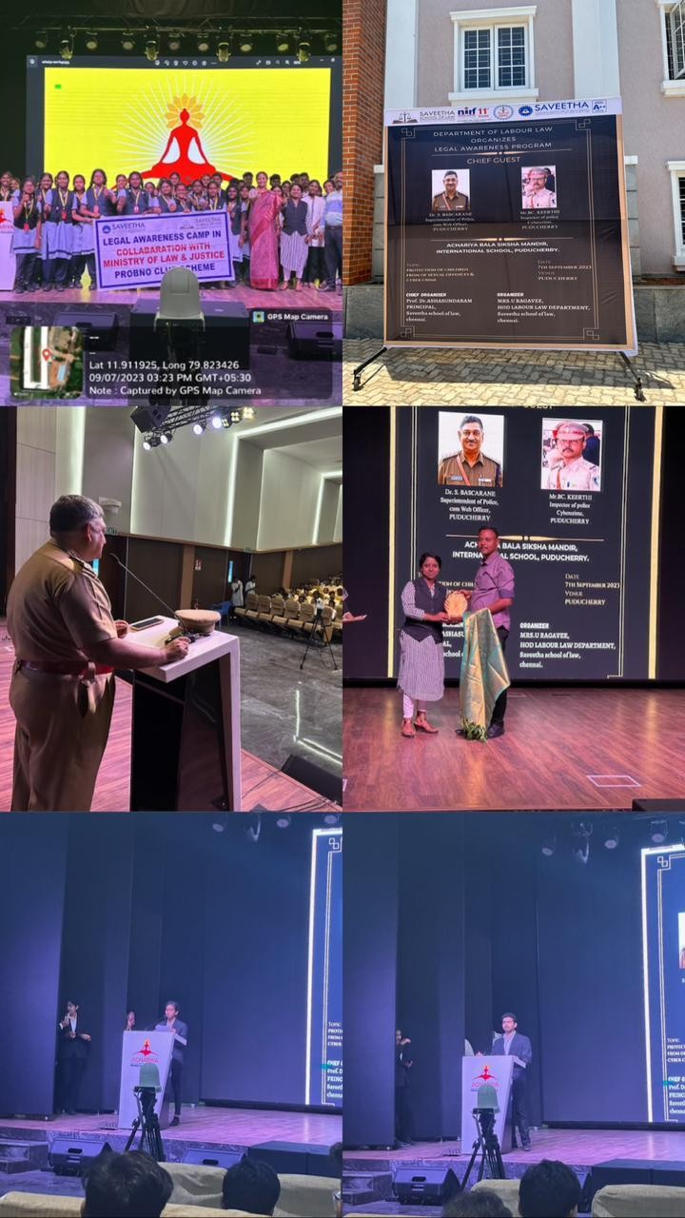
06
Legal Awareness Camp
On 07/09/2023, MRS.U.RAGAVEE, HOD of the Labour Department, organised an awareness session on Cyber law. Dr. S. BASCARANE, Superintendent of Police and Chief Web Officer of Puducherry, and Mr. BC. KEERTHI, Inspector of Police for Cybercrime, were the event's keynote speakers. Puducherry delivered and emphasised a speech on cyber laws, POCSO Act, 2015, and various cyber crimes. The purpose of the visit to Achariya Bala Siksha Mandir International School was to raise awareness about cyber law and the modes of cyber law in which cyber attacks were committed using cyber platforms, as well as the POCSO act and the Juvenile Justice Act, 2015.

Slide 7
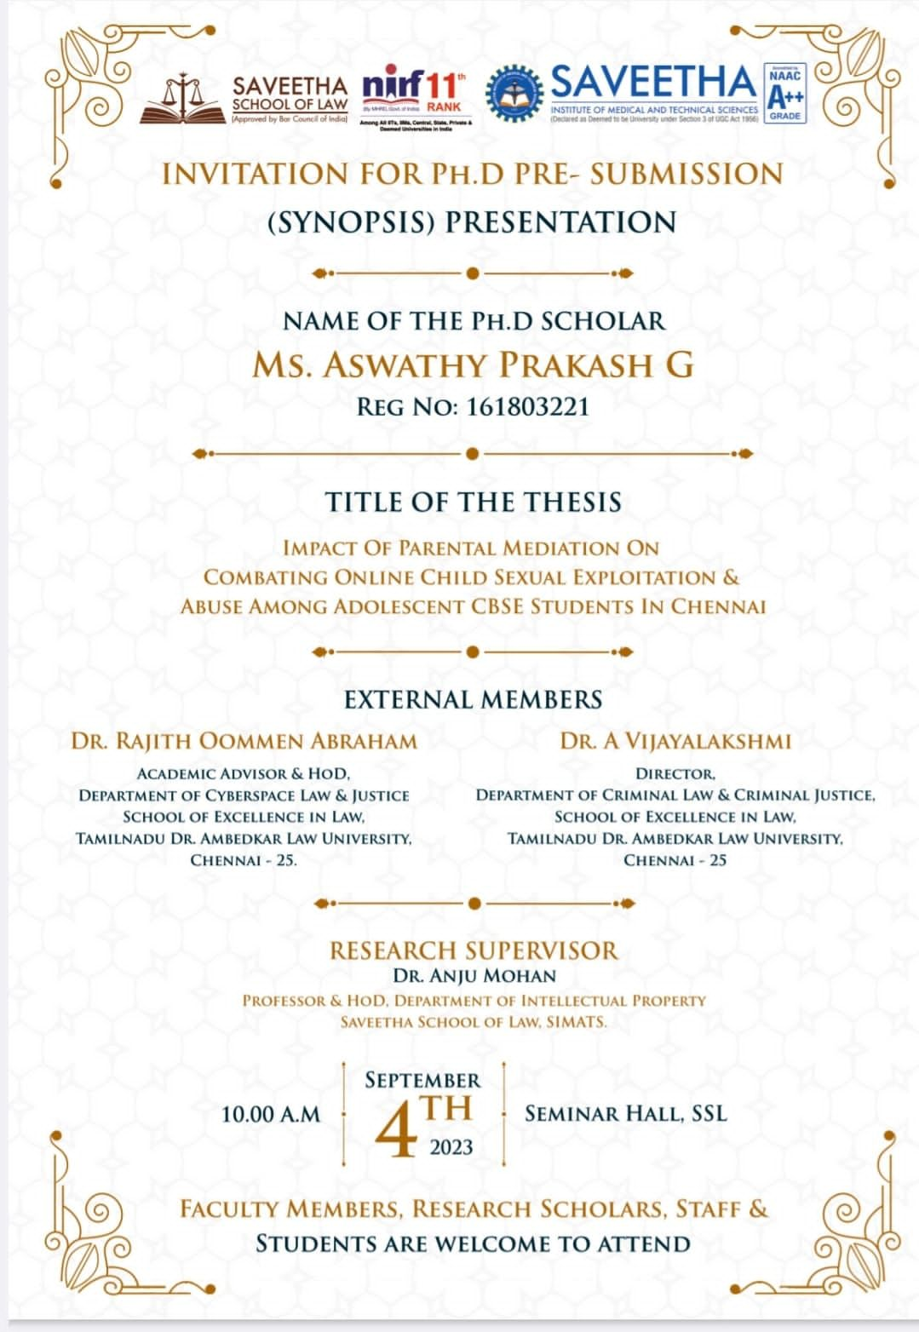
07
Ph.D. synopsis presentation
Saveetha School of Law Ph.D student submits synopsis on 4th September, 2023.
Research Supervisor: Dr.ANJU MOHAN
Research scholar. Ms.ASWATHY PRAKASH G
Venue : Saveetha School Of Law

Slide 8
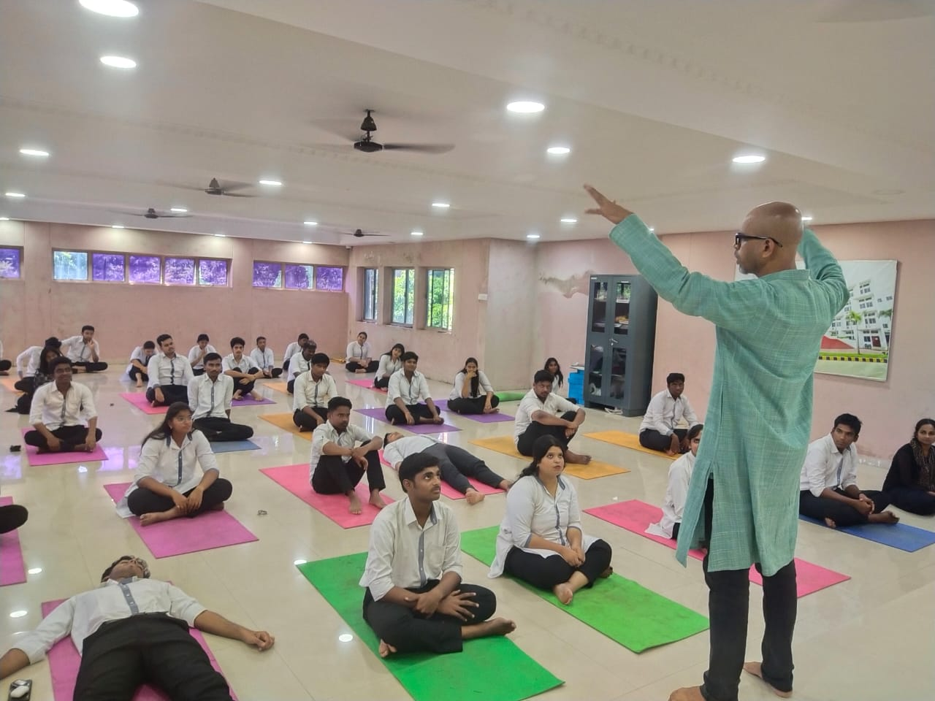
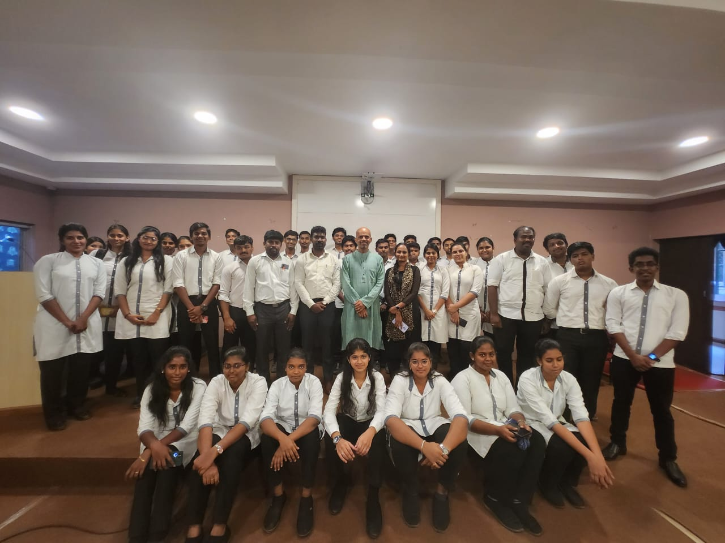
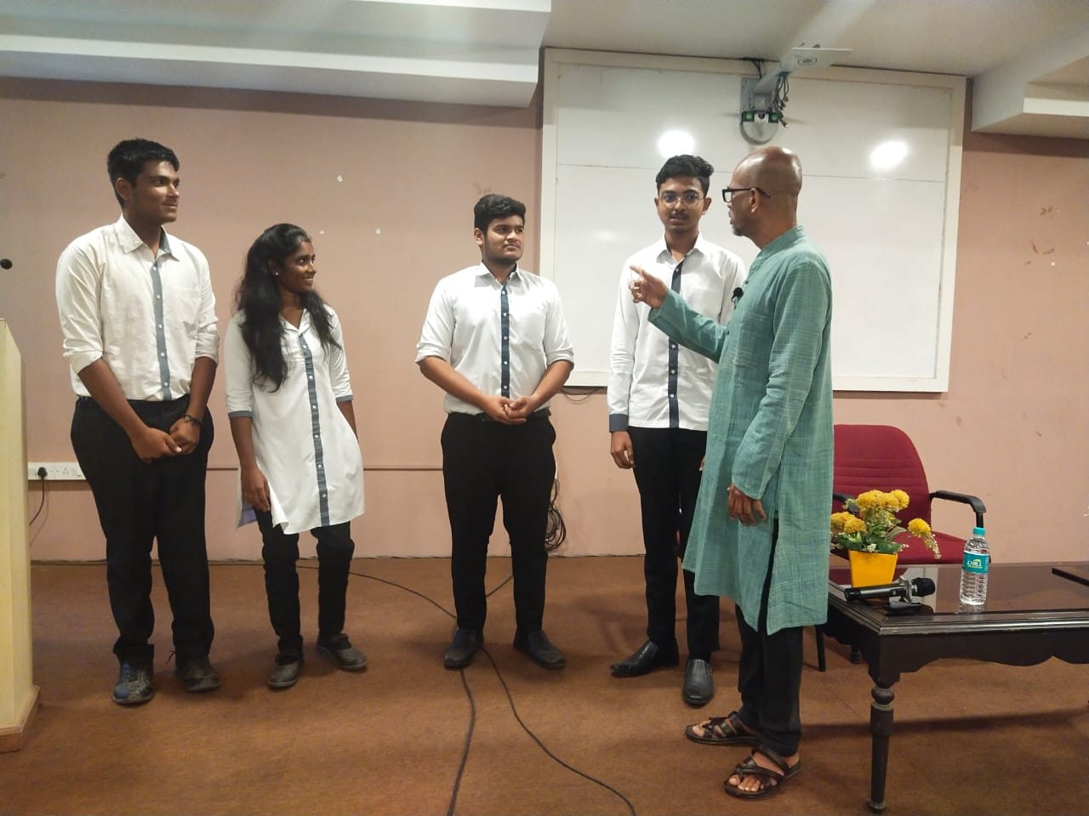
08
workshop
Department of Physical Education and Yoga, Saveetha School of Law Organised National Workshop on Sound Healing Therapy on 08/09/2023.

Slide 9
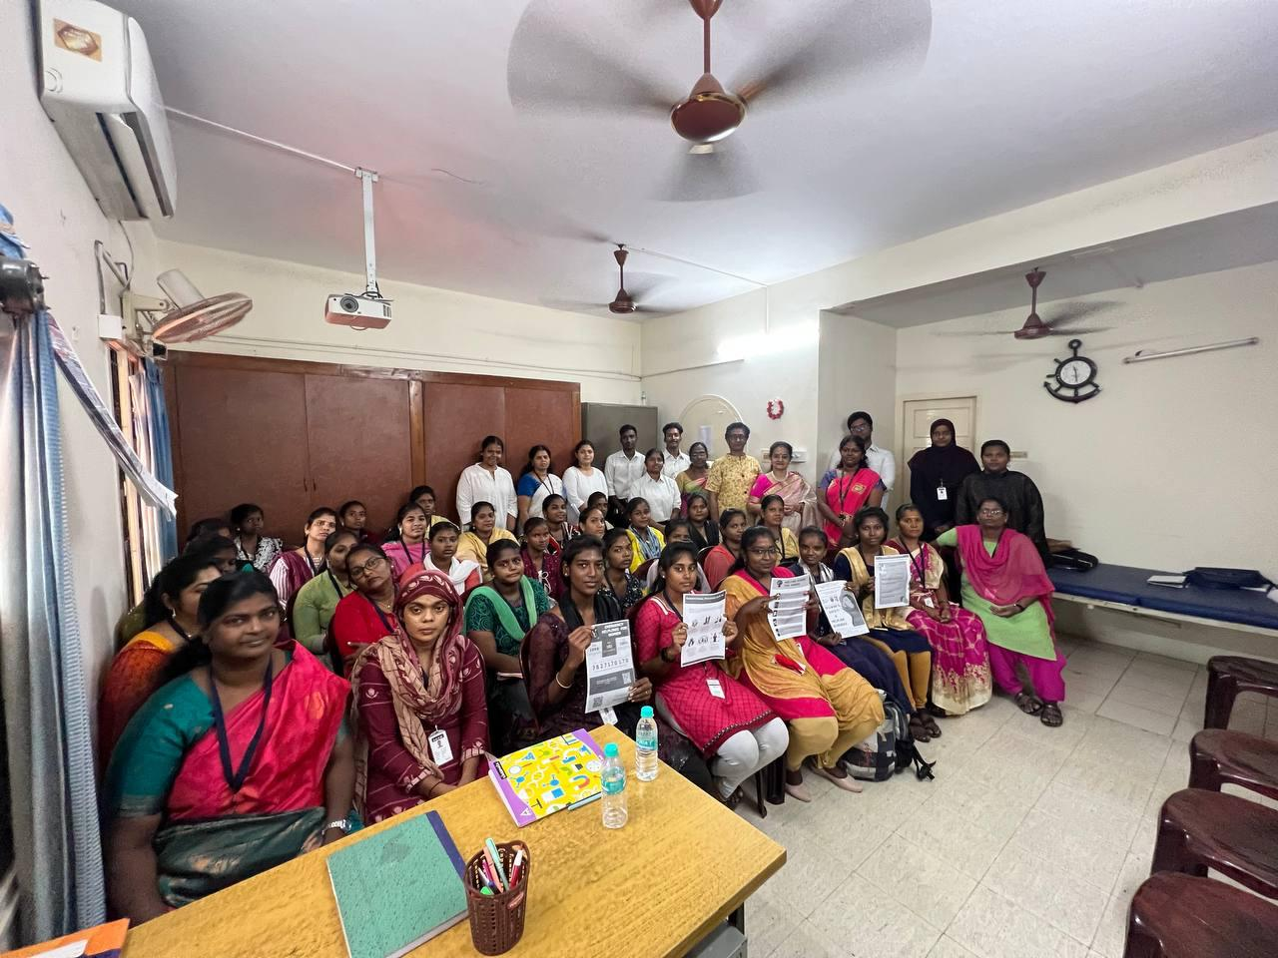
09
Legal Awareness Camp
The Department of IPR organised a Legal Awareness Campaign by partnering with an NGO placed at Anna Nagar wherein they exposed the participants on the legal rights they have got on laws pertaining to POSH.

Slide 10
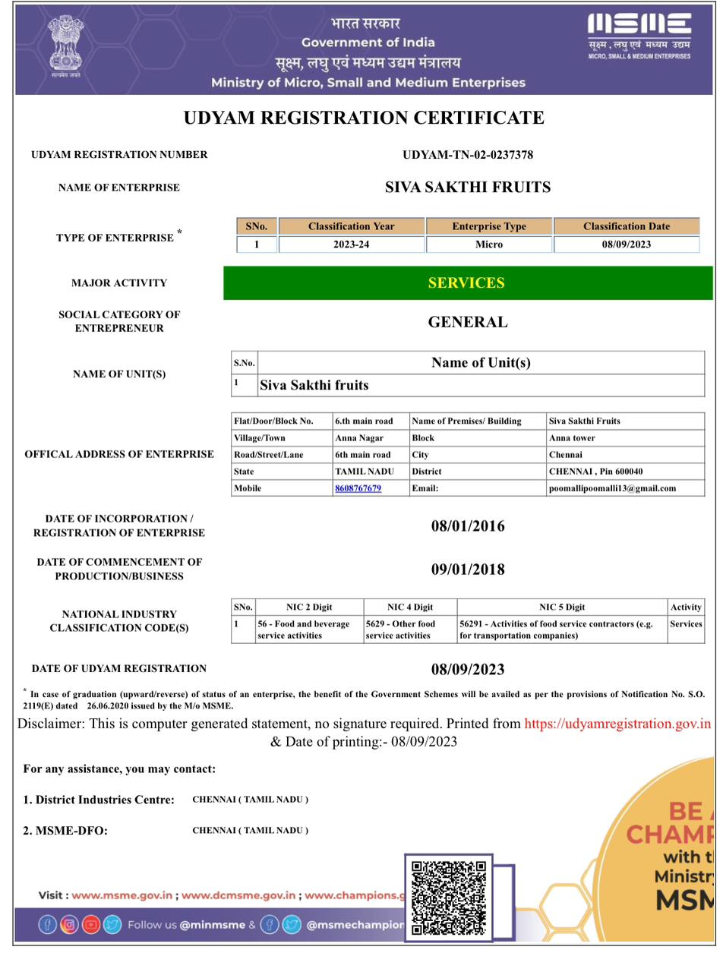
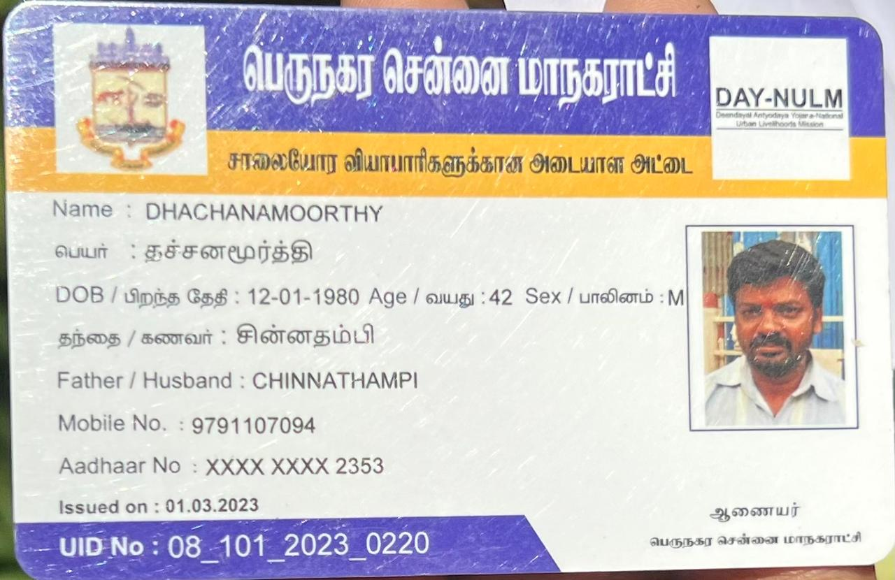
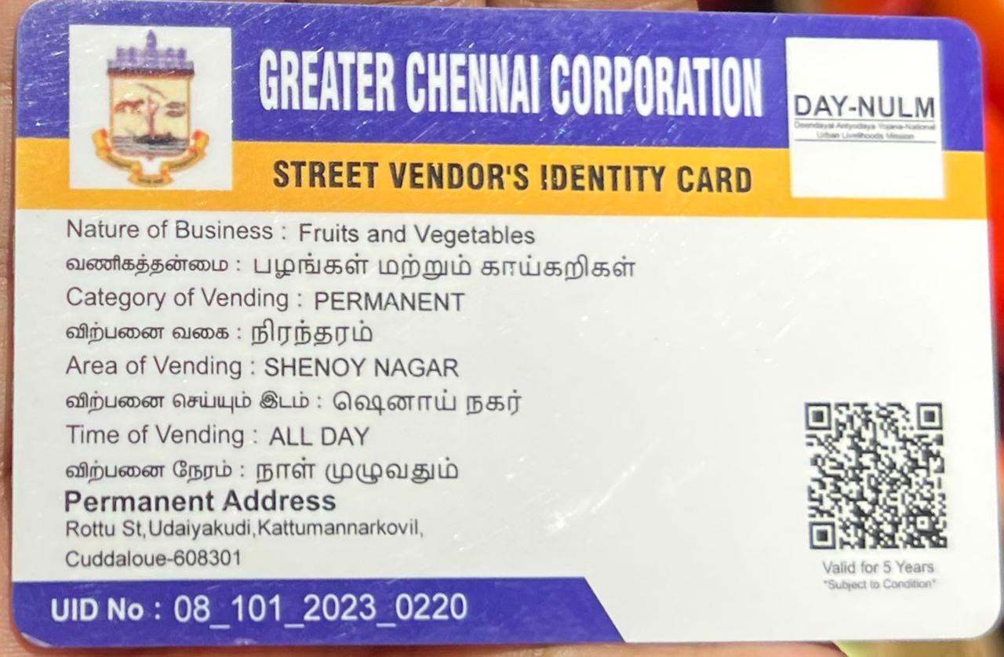
10
Legal Awareness Camp
The Department of IPR organised a event for Street Vendors to make them aware of the government schemes and to register them for MSME services for their further development.

Slide 11
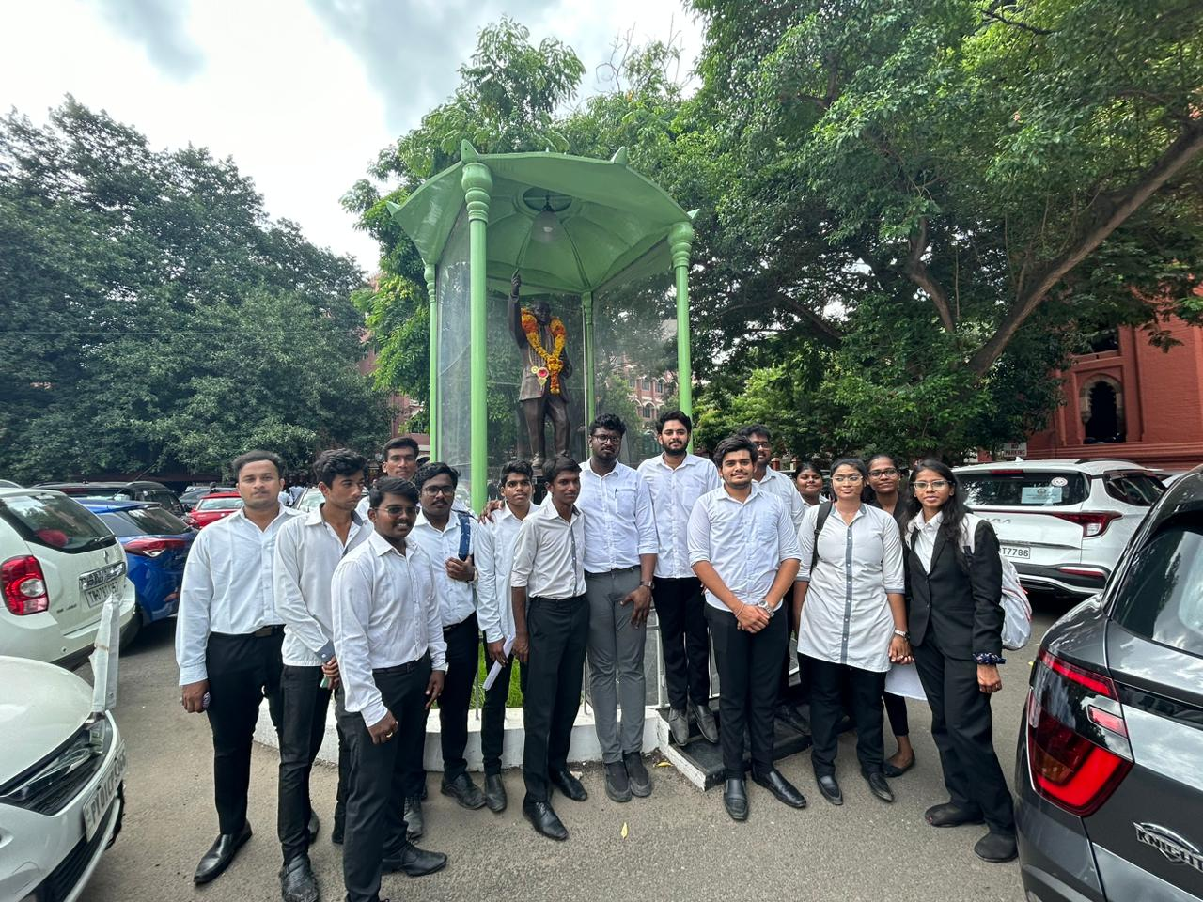
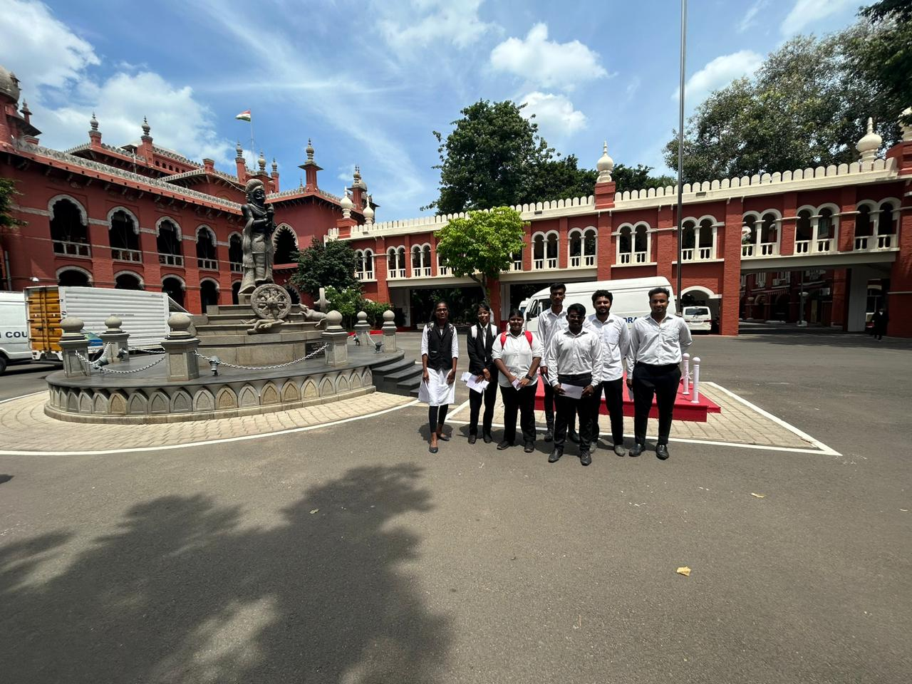
11
Legal Awareness Camp
The Department of IPR organised an event for the students DPC to visit the High Court of Madras and get to them a monthly pass for their future to understand nature of the litigation and the hierarchy of courts.

Slide 12
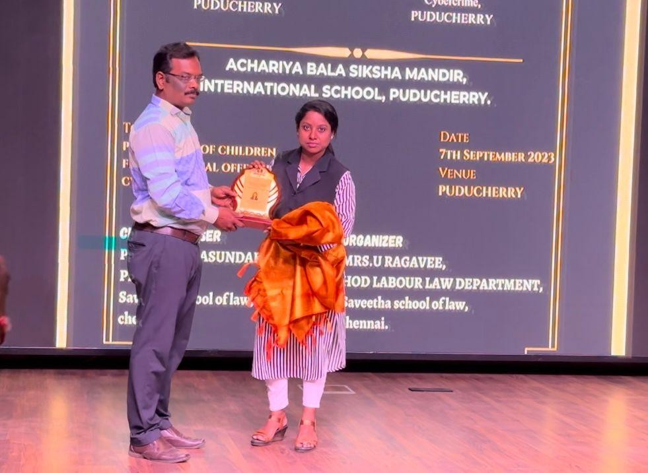
12
award
Mrs.U Ragavee, Assistant Professor, Department of Labour Law, Saveetha School of Law, was awarded the best faculty award for organising legal awareness programmes at various educational institutions. She has managed programmes and events in a well-organized and efficient manner.Staff and students from all programmes have expressed their gratitude for the programmes she has conducted on September 7, 2023 at Bala Siksha Mandir International School in Puducherry.

Slide 13
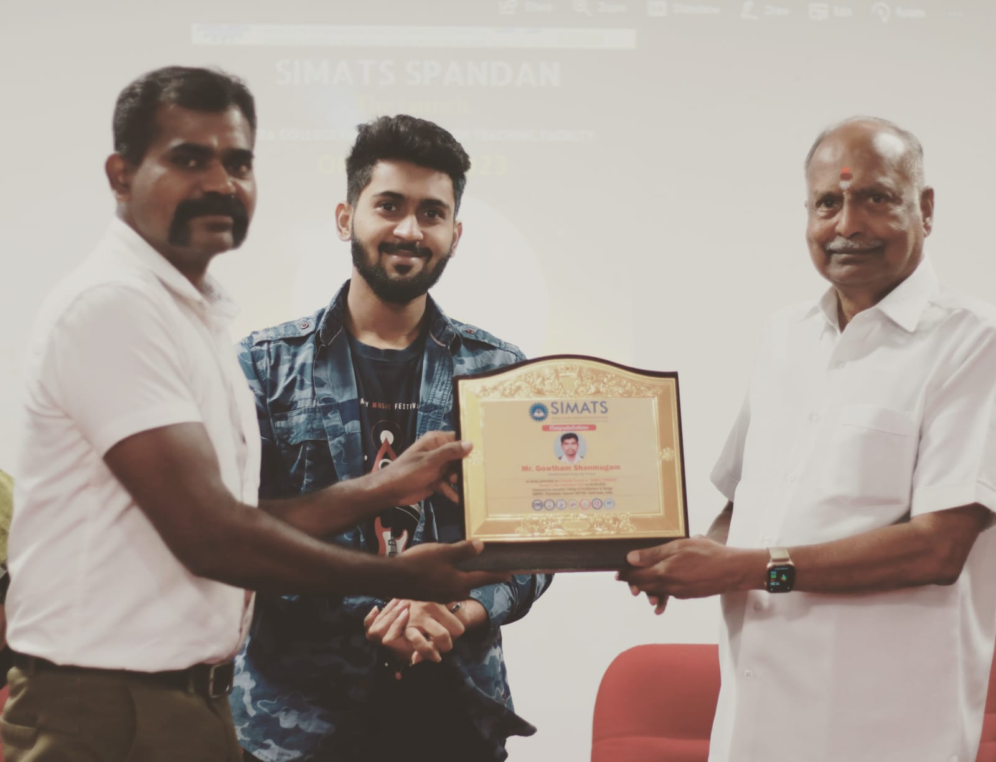
13
award
Mr. Gautham Shanmugam, Assistant Professor, Department of Management Studies, Saveetha School of Law, was honoured as the "Favourite Teacher" of students for fun learning in Saveetha School of Law on Teacher's Day celebration on 5.09.20232@ SCAD,SIMATS Thandalam.

Slide 14
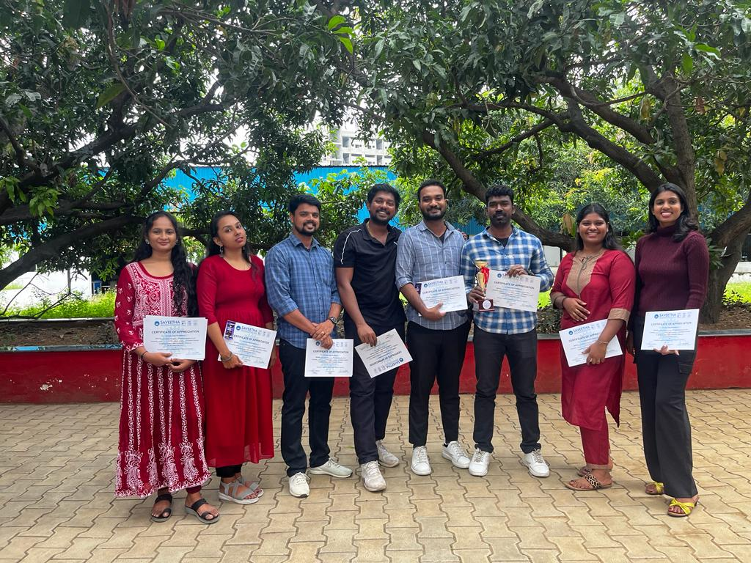
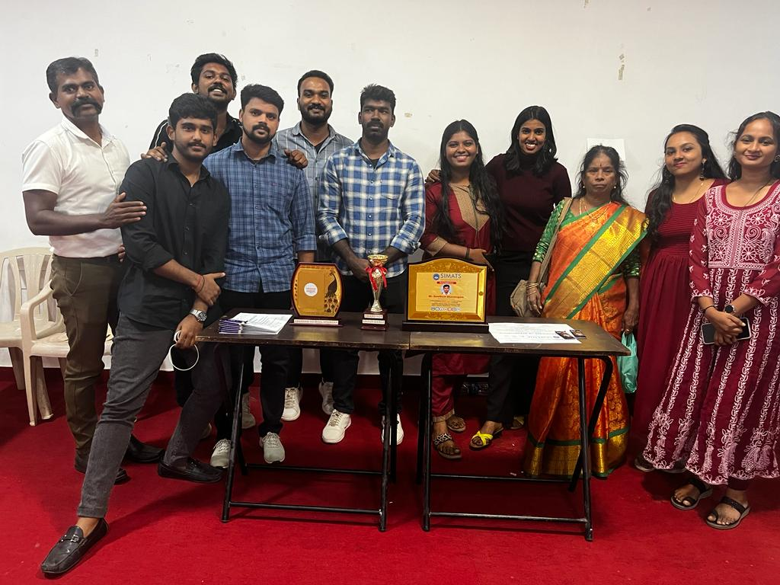
14
Award
Saveetha School of Law Faculties won first place in Group Dance in the SPANDAN Cultural Events on the occasion of Teachers Day Celebration at Saveetha College of Architecture and Design, SIMATS on 05/09/2023.

Slide 15
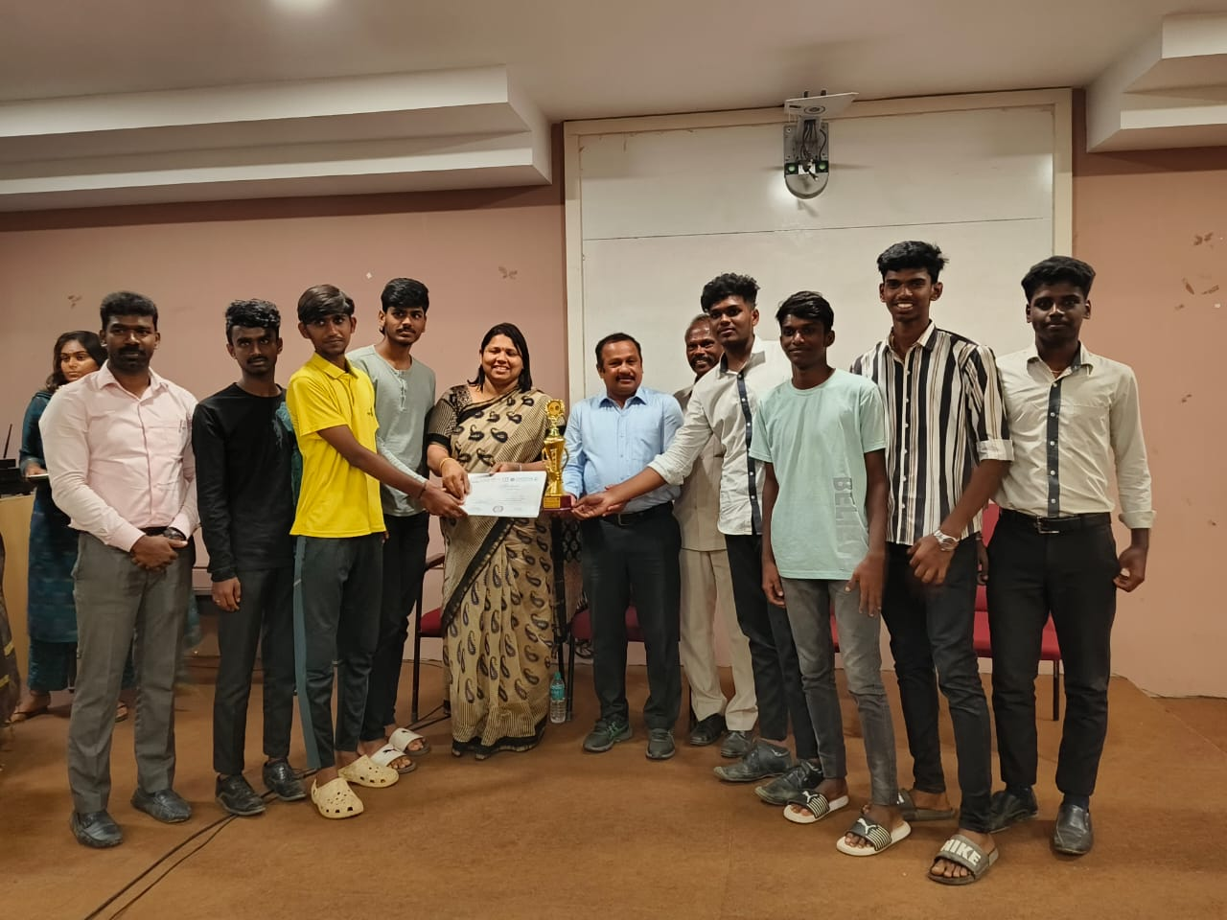
15
Award
Saveetha School of Law, Volleyball Men Team Secured Runners in Dhyan Chand Trophy Sports Tournament on 01/09/2023 at Saveetha School of Law.

Slide 16
16
Saveetha Law Firm - Last Week
S.No | Case Name | Court Name | Case Number | Status
1 | Sujaadh Vs The Director (SDC) | DCDRC - North | C.C.No.127 of 2023 | Vakalat

Slide 17
17
THANK YOU!

